Slide 1
Conceptual site model – table
Edit this document as much as you need to! (don’t forget to delete this box)
Primary Sources
Primary Transport Mechanisms
Secondary Sources
Secondary Transport Mechanisms
Exposure Pathways
Receptors
Source 1
Pathway 3
Source 2
You might need some of these connectors (copy/resize) – delete if unused

Slide 2
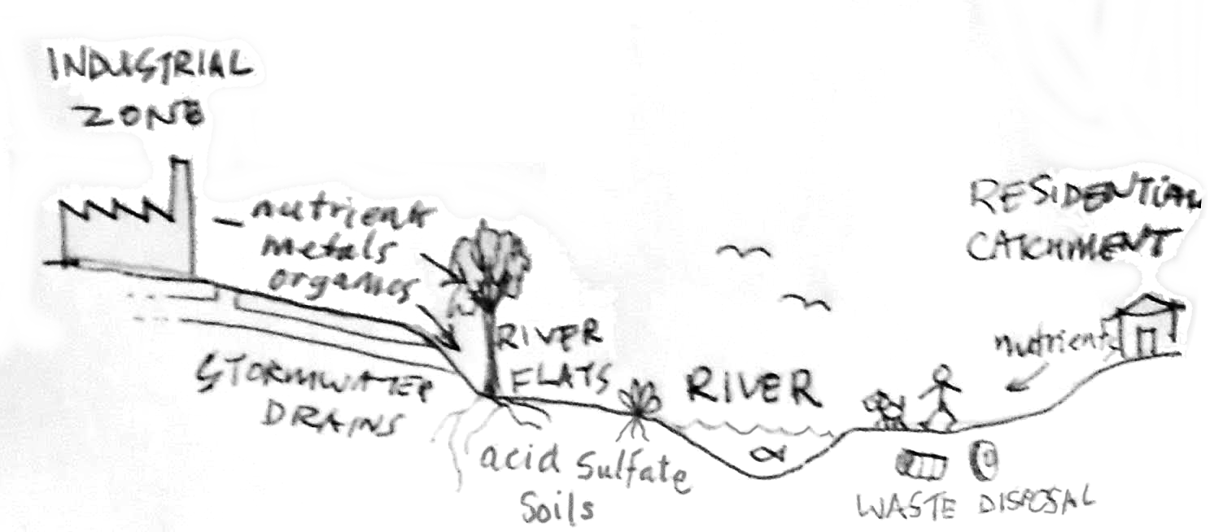
Conceptual site model – diagram
You can make a diagram by:
Annotating a map such as this one (do you need to show a wider area for your CSM? – think about the primary sources!)
Drawing a cross-section (e.g. using a line like the one labelled A-B-C on the map)
A sketch is perfectly adequate for the diagram – we’re not expecting fine art!

Slide 3
You can have another page for references

